Slide 1
HEPATO-BILIARY SYSTEM
MERON A.
AUG,2024

Slide 2
Contents
Physiologic anatomy of liver
Regulations of hepatic blood flow
Functions of liver
Evaluation of hepatic functions
Effects of anesthesia on liver functions
Anesthesia for liver diseases
  Hepatitis
  Cirrhosis
Anesthesia for biliary tract diseases
  Acute cholecystitis
  Obstructive jaundice

Slide 3
Liver and biliary system
The liver is the largest internal organ and is the body’s metabolic headquarter.
Located in RUQ weighing about 1.5-2.0 kg or about 2% of the total body weight in an adult
It has Rt and Lt lobes separated by falciform ligament the right lobe being larger than the left.
The functional unit of liver is lobules
The biliary system Rt and Lt hepatic ducts which combine to form common hepatic duct drains to the gall bladder by cystic ducts.

Slide 4
Blood supply
  The liver receives about 1.5Lmin-1 blood supply (about 25% of the total resting cardiac output) and is responsible for over 20% of the body’s resting oxygen consumption.
  It has a dual vascular supply from the portal vein and the hepatic artery.
  The hepatic artery is a high pressure and high resistance system which deliver 30% of total hepatic blood flow directly from the aorta and contributes to about 50% of total hepatic oxygen supply.

Slide 5
The portal vein is a valve less system, bringing deoxygenated blood from the large and small intestines, spleen, stomach, pancreas and gall-bladder.
It contributes to 70% of total liver blood flow and 50-60% of total oxygen supply, containing blood with a saturation of about 85%.

Slide 6
Nerve supply
  The liver is supplied by sympathetic nerve fibers (T6–T11), parasympathetic fibers (right and left vagus), and fibers from the right phrenic nerve.
  Splanchnic and vagal nerves contributes before forming hepatic plexus
  The majority of sensory afferent fibers travel with sympathetic fibers.

Slide 7
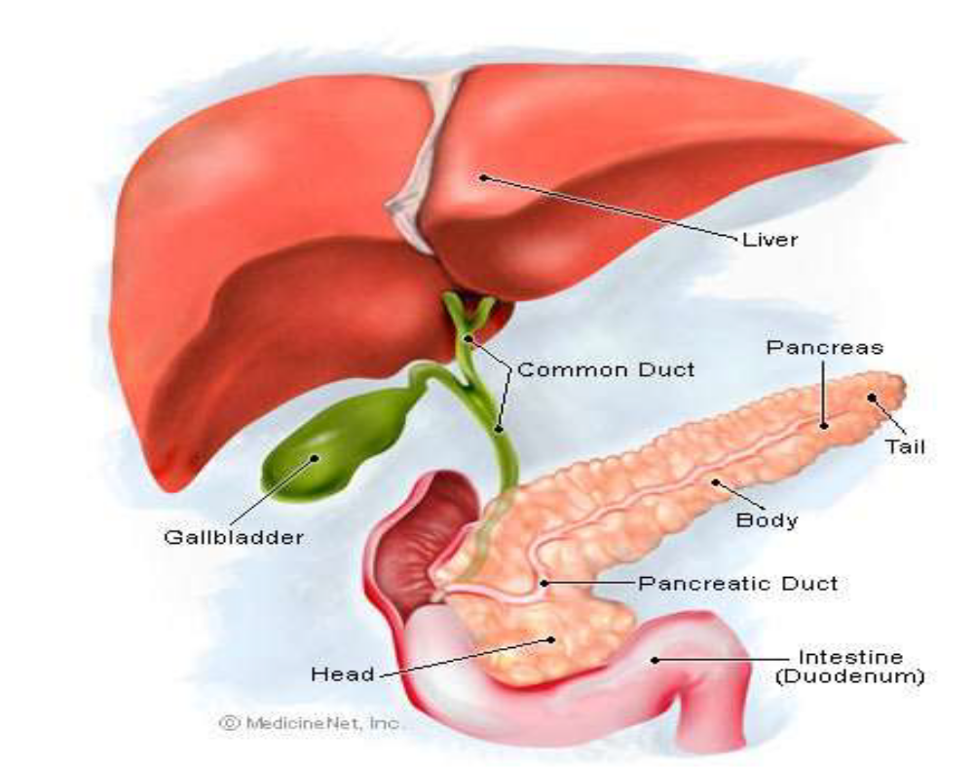

Slide 8
Regulation of hepatic circulation
Regulation of HBF is quite complicated than the other organs b/c of its dual blood supply
It can be regulated by both intrinsic and extrinsic mechanisms
A. Intrinsic mechanisms
  Hepatic artery buffer response(HABR)
  Metabolic control
  P-F auto-regulation

Slide 9
HABR:
  A decreased PV flow is well maintained by increasing hepatic arterial blood flow(adenosine-a mediator)
  An increased PV flow causes decreased hepatic arterial blood flow
  Therefore, the two sources of blood flow to liver has reciprocal relationship
Notes:
A decreased hepatic artery flow cannot be compensated by portal vein(rather, it depends on pressure in PV)

Slide 10
Metabolic control: food related
  Postprandial hyperosmolarity increases both portal & HBF b/c liver is very active during fed state than fasting state
Flow-autoregulation
  Less important during anesthetics b/c patients are in fasted state

Slide 11
B. Extrinsic mechanisms
  Neural control-recieves neural supply from T6-T11
    SNS stimulation-translocates blood volume from the splanchanic reservoir to the central circulation
    Decreased SNS tone-splanchnic reservoir volume increases
    The net effect is a redistribution of intrahepatic blood flow without changing total hepatic blood flow
  Humoral control-
    Glucagon - increases hepatic arterial blood flow.
    Angiotensin - decreases both portal and hepatic blood flow.
    Vasopressin - decreases both portal and hepatic blood flow

Slide 12
Increased liver blood flow
Decreased liver blood flow
Supine posture
Postprandial state
Hypercarbia
Acidosis
Acute hepatitis
Beta agonist
Phenobarbitone
Glucagon
Dopamine
Dopeximine
Upright posture
Hypocarbia
Hypoxia
IPPV/PEEP
Sepsis
Haemorrhage
Mesentric traction
Increased IA pressure
Vasopressin
Beta blockers
Alpha agonists
IV/inhalational anesthetics
Regional anesthesia

Slide 13
Liver functions
  Metabolism of carbohydrates, proteins and fat,
  Detoxification of drugs and toxins,
  Storage of glycogen, vitamins (e.g. A,D,E,C), iron and copper,
  Reservoir of blood,
  Filtration of bacteria, degradation of endotoxins and lactate metabolism,
  Excretion of bile and urea,
  Immunological functions with synthesis of immunoglobulins and phagocytic action by Kupffer cells ,
  Haemopoeisis in the foetus.

Slide 14
Carbohydrate metabolism
  The liver maintains glucose homeostasis during fasting by gluconeogenesis
  It is also a major site for glycogen storage, glycogenolysis and gluconeogenesis when glycogen stores are depleted.

Slide 15
Protein metabolism
  The liver has a central role in both protein metabolism and anabolism
  It removes amino acids from blood for gluconeogenesis and protein synthesis
  It also releases amino acids into the blood for utilization by peripheral tissues and
  Plays a major role in breakdown of amino acids, removing nitrogen in the form of urea.

Slide 16
The liver synthesizes many important proteins such as albumin, which is responsible for maintaining colloidal osmotic pressure, and globulins
Synthesis of almost all clotting factors occurs in the liver.
Coagulopathies can occur with either failure of hepatic synthesis or failure of bile excretion, leading to a reduction in absorption of vitamin K.
Vitamin K is required for the synthesis of factors II (prothrombin), VII, IX and X.
Notes:
Nearly all plasma proteins, with the notable exception of immunoglobulins, are formed by the liver. These include albumin, α 1 -antitrypsin and other proteases/elastases, and the coagulation factors. Albumin is responsible for maintaining a normal plasma oncotic pressure and is the principal binding and transport protein for fatty acids and a large number of hormones and drugs. Consequently, changes in albumin concentration can affect the concentration of the pharmacologically active, unbound fraction of many drugs.
All coagulation factors, with the exception of factor VIII and von Willebrand factor, are produced by the liver

Slide 17
Lipid metabolism
  Fatty acids and lipoproteins are synthesized and the liver is the major site for endogenous cholesterol and prostaglandin production.

Slide 18
Drug Metabolism
  Many exogenous substances, including most drugs, undergo hepatic biotransformation
  End products of these reactions are usually either inactivated or converted to more water-soluble substances that can be readily excreted in bile or urine.
  Hepatic biotransformations are often categorized as one of two types of reactions.
    Phase I reaction
    Phase II reaction

Slide 19
Phase I reactions:
  In these phase, drugs are made inactivated by cytochrome P450
  Results in oxidation, reduction, sulfoxidation, deamination, dealkaylation and methylation
  Barbiturates and benzodiazepines are examples of drugs inactivated by phase I reactions
  Some drugs might be degraded to active metabolites. Example meperidine, ketamine, morphine,….

Slide 20
Phase II reactions
  Involve conjugation of the substance with glucuronide, sulfate, taurine, or glycine.
  May/not follow phase I reaction
  The conjugated compound can then be readily eliminated in urine or bile.
Some enzyme systems, such as those of cytochrome P-450, can be induced by a few drugs, such as ethanol, barbiturates, ketamine, and perhaps benzodiazepines.

Slide 21
This can result in increased tolerance to the drugs’ effects.
Conversely, some agents, such as cimetidine and chloramphenicol, can prolong the effects of other drugs by inhibiting these enzymes
Factor affecting drug metabolism:
  Microsomal enzyme system
  Route of administration
  Liver blood flow
  Competitive inhibition
Notes:
Some drugs, including lidocaine, morphine, verapamil, labetalol, and propranolol, have very high rates of hepatic extraction from the circulation, and their metabolism is therefore highly dependent upon the rate of hepatic blood flow. As a result, a decrease in their metabolic clearance usually reflects decreased hepatic blood flow rather than hepatocellular dysfunction.

Slide 22
Bile metabolism
  The liver produces about one liter of bile per day which passes into the gall bladder and gets concentrated to one fifth of its original volume.
  Bile plays an important role in absorption of fat and excretion of bilirubin, cholesterol, and many drugs
  The bile acids formed by hepatocytes from cholesterol are essential for emulsifying the insoluble components of bile and facilitating the intestinal absorption of lipids.
  Bile consists of electrolytes, proteins, bilirubin, bile salts and lipids.

Slide 23
Defects in the formation or secretion of bile salts interfere with the absorption of fats and fat-soluble vitamins (A, D, E, and K).
Bile ducts from hepatic lobules join to become right and left hepatic ducts w/c in turn, combine to form the hepatic duct,
The hepatic duct together with the cystic duct becomes the common bile duct to the sphincter of oddi along with the pancreatic duct

Slide 24
Formation and excretion of bilirubin
  Bilirubin is primarily the end-product of hemoglobin metabolism
  Haemoglobin is broken down into haem and globin
  The heme ring is degraded in kupffer cells. Bilirubin is then released into circulation where it binds albumin
  Bilirubin is conjugated by the hepatocytes, primarily with glucuronide, and actively excreted into bile canaliculi
Notes:
Bilirubin is primarily the end-product of hemoglobin metabolism. It is formed from degradation of the heme ring in Kupffer cells. Bilirubin is then released into blood, where it readily binds to albumin. Hepatic uptake of bilirubin from the circulation is passive, but binding to intracellular proteins traps the bilirubin inside hepatocytes. Bilirubin is conjugated by the hepatocytes, primarily with glucuronide, and actively excreted into bile canaliculi.

Slide 25
Reservoir function
  Liver is compliant to accommodate extra blood when changes in hepatic veins occur
  A decrease in hepatic venous pressure, as occurs during hemorrhage, shifts blood from hepatic veins and sinusoids into the central venous circulation
Notes:
Portal vein pressure is normally only about 7–10 mm Hg, but the low resistance of the hepatic sinusoids allows relatively large blood flows through the portalvein. Small changes in hepatic venous tone andhepatic venous pressure thus can result in large changes in hepatic blood volume, allowing the liver to act as a blood reservoir
Due to its ability to distend, the liver is capable of storing up to 1 L of blood. The liver serves as a reservoir capable of accepting blood, or releasing blood at times of low blood volume. The liver also stores vitamins, particularly vitamins B12 (1-year supply), D (3-month supply), and A (10-month supply). Excess body iron is transported via apoferritin to the liver for storage as ferritin, which is released when circulating iron levels are low. Thus, the liver apoferritin system serves as a blood iron buffer.

Slide 26
Assessment of liver function
Despite the numerous synthetic, excretory and detoxification functions carried out by the liver, only a few can be measured by means of blood tests.
The standard liver function tests (LFTs) measure the concentrations of various proteins and enzymes in the blood that are either produced by liver cells or released when liver cells are damaged.
They can be divided into measures of liver function, cell injury and biliary obstruction.

Slide 27
Tests of hepatic synthetic function
Focus on the measurement of serum albumin and coagulation testing.
Prothrombin time (PT)
  Is a measure of the extrinsic pathway of coagulation, it measures factors I, II, V, VII and X.
  Normal PT value is 11-14 seconds
  The PT depends upon sufficient intake of vitamin K, which in turn depends upon adequate biliary secretion of bile salts.
  Prolongation can reflect deficiencies of vitamin K relating to impaired absorption from poor quality bile production or abnormalities in factor VII synthesis, both relating to liver dysfunction.
Notes:
The PT, which normally ranges between 11–14 sec, depending on the control value, measures the activity of fi brinogen, prothrombin, and factors V, VII, and X. Th e relatively short half-life of factor VII (4–6 h) makes the PT useful in evaluating hepatic synthetic function of patients with acute or chronic liver disease. Prolongations of the PT greater than 3–4 sec from the control are considered signifi cant and usually correspond to an INR >1.5. Because only 20% to 30% of normal factor activity is required for normal coagulation, prolongation of the PT usually refl ects either severe liver disease or vitamin K defi ciency. (See Table 32–5
for a list of coagulation test abnormalities.)

Slide 28
The PT and international normalized ratio (INR) are sensitive indicators of hepatic disease because of the short half-life of factor VII (4-6hrs).
In patients with biliary obstruction, the PT can be prolonged despite preserved hepatic function.
Other conditions that can affect the PT in the absence of liver disease include
  Congenital coagulation factor deficiencies,
  Consumptive coagulopathies such as disseminated intravascular coagulation (DIC), and
  Warfarin therapy.

Slide 29
Albumin
  Albumin is synthesized in the liver
  The normal serum albumin concentration is 3.5–5.5 g/dL.
  Low serum albumin may reflect liver dysfunction.
  Hypoalbuminaemia also occurs in malnutrition, nephrotic syndrome, malabsorptive states and late pregnancy
  Because its half-life is about 2–3 weeks, albumin concentration may initially be normal with acute liver disease.
  Albumin values less than 2.5 g/dL are generally indicative of chronic liver disease, acute stress, or severe malnutrition.

Slide 30
Tests of hepatocellular injury
These incorporate measure of AST or ALT
These enzymes elevate in a state of hepatocellular injury, however there is no correlation between levels and degree of damage
Alanine and aspartate aminotransferase
  These enzymes are released into the circulation as a result of hepatocellular injury or death.
  Are also involved in hepatic gluconeogenesis

Slide 31
ALT is a cytoplasmic enzyme that is highly specific to the liver, but the cytoplasmic and mitochondrial isoenzymes of AST are present in extrahepatic tissues as well.
Because AST is also found in nonhepatic tissues (including the heart, skeletal muscle, kidney, and brain), elevations are not specific for hepatic disease
ALT is primarily localized to the liver.
Normal AST and ALT levels are below 35–45 U/L.

Slide 32
Tests of biliary obstructions
Alkaline phosphatase
  Alkaline phosphatase is produced by the liver, bone, small bowel, kidneys, and placenta and is excreted into bile.
  Most of circulating enzyme derive from liver and bone
  Normal serum alkaline phosphatase activity is generally 25–85 IU/L; children and adolescents have much higher levels, reflecting active growth.
  ALP is elevated in biliary obstruction, pregnancy and as a by-product of osteoblast activity eg Paget’s disease.
  Alkaline phosphatase has a serum half-life of approximately 1 week, so the level remains elevated for several days after resolution of biliary obstruction.

Slide 33
Bilirubin
  Bilirubin is the degradation product of hemoglobin and myoglobin
  The normal total bilirubin concentration, composed of conjugated (direct), water-soluble and unconjugated (indirect), lipid-soluble forms, is less than 1.5 mg/dL (<25 mmol/L) and reflects the balance between bilirubin production and excretion
  Bilirubin is elevated by any of the following: haemolysis, biliary stricture, hepatitis, cirrhosis, drugs (eg antipsychotics and sulphonamides) and Gilberts syndrome

Slide 34
Jaundice is usually clinically obvious when total bilirubin exceeds 3 mg/dL.
A predominantly conjugated hyperbilirubinemia (>50%) is associated with increased urinary urobilinogen and may reflect hepatocellular dysfunction, congenital or acquired intrahepatic cholestasis, or extrahepatic biliary obstruction
Unconjugated bilirubin is neurotoxic, and high levels may produce encephalopathy

Slide 35
Blood ammonia
  Ammonia is produced from amino acid metabolism
  Significant elevations of blood ammonia levels usually reflect disruption of hepatic urea synthesis.
  Normal whole blood ammonia levels are 47–65 mmol/L (80–110 mg/dL).
  Marked elevations usually reflect severe hepatocellular damage and may cause encephalopathy.

Slide 36
Effects of anesthetics on hepatic functions
Anesthesia & anesthetic drugs affects the hepatic function by following mechanisms
  Alteration in the hepatic blood flow and HABR.
  Metabolic function.
  Drug metabolism.
  Biliary function.

Slide 37
Hepatic blood flow usually decreases during regional and general anesthesia
Multiple factors are responsible, including both direct and indirect effects of anesthetic agents, the type of ventilation employed, and the type of surgery being performed
Decreases in cardiac output reduce hepatic blood flow via reflex sympathetic activation, which vasoconstricts both the arterial and the venous splanchnic vasculature

Slide 38
The hemodynamic effects of ventilation can also have a significant impact on hepatic blood flow.
Controlled PPV with high mean airway pressures reduces venous return to the heart and decreases cardiac output; both mechanisms can compromise hepatic blood flow.
Positive end-expiratory pressure (PEEP) further accentuates these effects.
Surgical procedures near the liver can reduce hepatic blood flow up to 60%.

Slide 39
β-Adrenergic blockers, α 1 -adrenergic agonists, H 2 -receptor blockers, and vasopressin reduce hepatic blood flow.
Low-dose dopamine infusions may increase liver blood flow.
The neuroendocrine stress response to surgery may be at least partially blunted by regional anesthesia, deep general anesthesia and/or pharmacological blockade of the sympathetic system

Slide 40
IV anesthetics
Ketamine has little impact on hepatic blood flow
Propofol increases Blood Flow in both the hepatic arterial and portal venous circulation, suggesting a significant splanchnic vasodilator effect
Etomidate and thiopental at larger doses (>500 mg) may cause hepatic dysfunction by ↓ hepatic blood flow, either from ↑ hepatic arterial vascular resistance or from reduced cardiac output and blood pressure.

Slide 41
Inhalational anesthetics
Inhalational anesthetics affect carbohydrate metabolism in several ways. Ether, unlike the newer agents, enhances the breakdown of glycogen in the liver.
Halothane has been shown experimentally, to decrease the rate of glycogenesis, inhibit insulin release and inhibit the effect of insulin on the tissues
Halothane and ether both inhibit the cytochrome p450 enzyme system, slowing the oxidative metabolism of drugs; gluconuride conjugations are not affected
  Fentanyl, ketamine, lignocaine, pancuronium and propranolol have prolonged half life

Slide 42
Enflurane: Increase in hepatic vascular resistance
Isoflurane: Increase in microvascular blood velocity and preserved hepatic blood flow
Sevoflurane & Desflurane: Preservation of hepatic blood flow & function
In general; isoflurane, sevoflurane and desflurane are safe to use

Slide 43
Opioids
Opioids have little effect on hepatic function, provided they do not impair hepatic blood flow and oxygen supply
All opioids can potentially cause spasm of the sphincter of Oddi and increase biliary pressure.
Naloxone and glucagon may relieve opioid-induced spasm.

Slide 44
Surgery
Upper abdominal surgery is associated with the greatest reduction in hepatic blood flow
Splanchnic traction and exploratory laparotomy can reduce blood flow to the intestines and the liver

Slide 45
Effects of hepatic dysfunction on pharmacokinetics
Liver disease may have a significant impact on drug metabolism and pharmacokinetics as a result of
  Alterations in protein binding,
  Reduced levels of serum albumin
  Altered volume of distribution because of ascites and increased total-body water compartments, and
  Reduced metabolism secondary to abnormal hepatocyte function

Slide 46
The impact of long-term alcohol ingestion on hepatic enzyme induction may also influence the ultimate effect of drugs in patients with cirrhosis
The efficiency of drug removal by the liver is determined by several factors including
  Hepatic blood flow,
  Hepatic enzyme activity and efficiency,
  The extent of plasma protein binding,
  Cholestasis-induced alterations in the entero-hepatic circulation and
  Metabolism of enteral drugs,
Notes:
Altered hepatic blood flow affects metabolism of drugs with high extraction ratio. While altered protein binding affects metabolism of drugs with low extraction ratio.

Slide 47
Opioids:
  The significantly reduced metabolism of morphine in patients with advanced cirrhosis leads to a prolonged elimination half-life
Morphine:
  Markedly increased bioavailability of orally administered morphine, decreased plasma protein binding, and potentially exaggerated sedative and respiratory-depressant effects
The clearance may be contributed by extrahepatic clearance and oral dose should be reduced

Slide 48
Meperidine
  A 50% reduction in clearance and a doubling of the half-life have been observed
  Clearance of normeperidine is reduced, and patients with severe liver disease may experience neurotoxicity
Fentanyl:
  A highly lipid soluble synthetic opioid that has a short duration of action after a single intravenous bolus dose because of rapid redistribution into storage sites.
  With repeated administration or continuous infusions, accumulation may occur and lead to prolonged effects in advanced liver disease

Slide 49
Sufentanil:
  A more potent but similar synthetic lipophilic opioid, is also extensively metabolized by the liver and is highly protein bound
  Single-dose pharmacokinetics is not significantly altered in patients with cirrhosis, although the impact of continuous infusions and reduced protein binding is as ill-defined for sulfentanil as for fentanyl

Slide 50
Remifentanil:
  Is a synthetic opioid with an ester linkage that allows for rapid hydrolysis by blood and tissue esterases
  Such hydrolysis leads to high clearance, rapid elimination, and recovery that is almost independent of the dose or duration of infusions
  The clearance and elimination of remifentanil are indeed unaltered in patients with severe liver disease or in those undergoing liver transplantation

Slide 51
Sedative-hypnotics
Thiopental
  Has a small hepatic extraction ratio, and its metabolism and clearance are affected in patients with liver disease
  However, the elimination half-life of thiopental is unchanged in cirrhotic patients, possibly b/c of large V/D
  A prolonged effect from standard doses of thiopental thus seems unlikely in this patient population.

Slide 52
In contrast, other intravenous anesthetics, including methohexital, ketamine, etomidate, and propofol, are highly lipid soluble, are metabolized by the liver, have a large hepatic extraction ratio, and should have diminished clearance in the presence of advanced liver disease
Etomidate clearance is unchanged in cirrhotic patients, although increased volumes of distribution may prolong the elimination half life and result in unpredictable recovery times

Slide 53
BZDs
Midazolam:
  The reduced clearance in patients with end-stage liver disease produces prolonged elimination half-lives
  Multiple dosage or infusion would result in prolonged duration of action and an enhanced sedative effect reduced protein binding and increased free fractions of midazolam
  Similar effects expected from diazepam
  Oxazepam & lorazepam are safe in mild to moderate liver impairment

Slide 54
NMBDs: decreased albumin, increased Vd, impaired biliary excretion, and decreased plasma pseudo cholinesterase activity affects their metabolism in cirrhosis
Drugs with hepatic clearance avoided
  Vecuronium
  Rocuronium
  Pancuronium
  Mivacurium (infusion avoided)

Slide 55
Atracurium (nonspecific ester hydrolysis) and cisatracurium (Hofmann elimination), have elimination half-lives and clinical durations of action similar to those observed in normal patients
  Their clinical effect is unaltered in advanced liver disease
The unique elimination of mivacurium by plasma cholinesterase is, however, altered by cirrhosis
  Associated with significantly longer recovery and has a longer elimination half-life

Slide 56
Lowered cholinesterase levels have been observed in these individuals, and they may prolong the effect of succinylcholine
Careful monitoring of neuromuscular function is recommended whenever muscle relaxants are used in this patient population

Slide 57
Liver failure and Anesthesia
Liver disease has a spectrum of severity from subclinical disease through to end-stage liver disease.
Identifying the population of patients with liver disease can be challenging, because clinical manifestation of liver dysfunction occur only after a substantial decline in liver function has occurred.
The range of symptoms a patient has depends on whether the disease presentation is acute or chronic.
Notes:
Hepatic disease can lead to multisystem organ dysfunction with multiple significant anaesthetic implications. Pathophysiological alterations can occur in pharmacological responses, the systemic and pulmonary circulations, coagulation, and neurological function. Perioperative risk is determined by both patient-specific and procedural factors.
When patients with liver disease need surgery, anaesthesiologists face several perioperative challenges. Patients with liver disease have physiological perturbations that range from mild hyperbilirubinemia of no clinical consequence to severe coagulopathy and metabolic disarray

Slide 58
Liver disease may be the result of a variety of causes, which include
  Developmental or genetic defects,
  Metabolic abnormalities,
  Autoimmune diseases,
  Infectious diseases,
  Neoplasm,
  Alcohol,
  Environmental toxins, and
  Drug toxicity
Worldwide, the major cause of liver disease is viral infection.

Slide 59
Acute liver failure
  Results from the rapid development of hepatocellular dysfunction, and the diagnosis is based both on clinical examination and blood test results.
  It is defined as the rapid development of jaundice, coagulopathy (INR>1.5) and encephalopathy, in a patient without prior liver disease and who has had an illness of <26 weeks’ duration.
  Acute illnesses may resolve spontaneously, segue into chronic disease, or result in acute liver failure (ALF).
Notes:
ALF (previously termed fulminant hepatic failure) is deined as the appearance of encephalopathy together with coagulopathy, usually an INR 1.5, in a patient who has no previous history of liver disease and who has had an illness of <26 weeks’ duration.
Acute liver failure is defined as the rapid development of severe liver damage with impaired synthetic function and encephalopathy in someone who previously had normal liver function or well-compensated liver disease. By definition, acute liver failure develops in less than 4 weeks (measured from the first appearance of physical signs such as jaundice to the loss of 80% to 90% of hepatic function). Acute liver failure includes fulminant hepatic failure, that is, liver failure that occurs within 8 days of the onset of symptoms. Acute liver failure often affects young people and carries a very high mortality. The underlying cause and the grade of encephalopathy on presentation are important determinants of outcome.
Liver disease can be divided into two main groups on the basis of the primary anatomy affected. Processes may be considered primarily hepatocellular (parenchymal) or biliary. Progressive biliary disease may eventually lead to ibrotic changes and cirrhosis, but it is characteristic of the biliary diseases that cholestasis precedes hepatocellular dysfunction. In hepatocellular diseases evidence of cholestasis and synthetic dysfunction appear synchronously

Slide 60
Etiologies
  The most common causes for acute liver disease are drug toxicity and viral infection.
  Other causes include idiopathic, alcoholic hepatitis, autoimmune, ischemic, non acetaminophen drug toxicity, and pregnancy-related hepatic diseases, wilson’s disease and reyes syndrome
Etiology has some bearing on outcome, with the most favorable prognosis for patients with acetaminophen overdose, ischemic injury, and hepatitis A and
Poor prognoses for those with non acetaminophen drug induced liver injury (DILI), acute hepatitis B, Wilson’s disease, and autoimmune hepatitis

Slide 61
Clinical features
  Clinical features of acute liver failure range from non-specific nausea and abdominal discomfort to confusion, agitation and coma
  The diagnosis is confirmed by abnormalities of liver function tests and coagulation, in conjunction with features of encephalopathy
Notes:
Diagnosed and graded clinically hepatic encephalopathy is due to the accumulation of toxic products of protein breakdown and gut bacterial metabolism. When the liver is unable to clear these substances it can result in elevated ammonia.

Slide 62
Chronic liver disease
  Chronic liver disease involves a disease process of progressive destruction and regeneration of the liver parenchyma leading to fibrosis and cirrhosis
  The most common causes of chronic liver disease are viral hepatitis (hepatitis B and C), autoimmune disease, and alcoholic liver disease
  Along with cytomegalovirus and Epstein-Barr virus, toxins such as alcohol, amoidarone and methotrexate

Slide 63
The range of symptoms shown by patients with chronic liver disease is often superimposed on a background of chronic ill health and poor nutrition
The common complications of chronic liver disease such as ascites, hyper-splensism and a collateral venous circulation producing lower oesophageal and gastric varices, all result from portal hypertension
Clinical examination may reveal the classical stigmata of chronic liver disease such as clubbing, palmar erythema, spider nevi, scratch marks, gynaecomastia, testicular atrophy, and caput medusa.

Slide 64
Hepatitis
  Hepatitis is an inflammatory disease of the liver parenchyma
  It is often due to viral infection but can also be caused by autoimmune mechanisms or by ingestion of chemicals, such as drugs, alcohol, or solvents that are toxic
  Hepatitis may occur with minimal symptoms but is frequently complicated by at least malaise and jaundice
  It can be categorized as acute or chronic hepatitis

Slide 65
Acute hepatitis
  This illness represents acute hepatocellular injury with a variable degree of cellular necrosis
  Acute hepatitis is usually the result of a viral infection, drug reaction, or exposure to a hepatotoxin
  Acute Viral hepatitis is most commonly due to hepatitis A, hepatitis B, or hepatitis C viral infection
  At least two other hepatitis viruses have also been identified: hepatitis D (delta virus) and hepatitis E (enteric non-A, non-B).

Slide 66
Hepatitis A virus is the most common cause of acute viral hepatitis (50%), followed in incidence by hepatitis B virus (35%) and hepatitis C virus (15%)
Hepatitis D virus occurs only in patients with hepatitis B and is present as a co-infection
Diagnosis is based on clinical presentation and laboratory investigations
Definitive diagnosis may require serology and liver biopsy
Treatment of acute viral hepatitis is symptomatic. Avoidance of alcohol consumption, restriction of excessive physical exertion, and good nutrition are essential.

Slide 67
Drug-induced hepatitis can result from direct, dose-dependent toxicity of a drug or drug metabolite, an idiosyncratic drug reaction, or a combination of these two causes
A large variety of medications (analgesics, antibiotics anticonvulsants, antihypertensives, and many others) can cause hepatic inflammation resulting from idiosyncratic reaction or dose-related toxicity
The onset of clinical signs is usually 2 to 6 weeks after exposure but can be delayed for as long as 6 months after starting the medication.

Slide 68
The clinical course and the histologic appearance of the liver often resembles viral hepatitis, making diagnosis difficult
Acetaminophen overdose is a well-known cause of hepatocellular toxicity and liver necrosis.
Acetaminophen ingestion of 25 g or more usually results in fatal fulminant hepatotoxicity
Oral N-acetylcysteine administration within the first 8 hours after acetaminophen ingestion can dramatically reduce the extent of parenchymal injury

Slide 69
Autoimmune Hepatitis
  Autoimmune hepatitis is an inflammatory condition of the liver that is caused by a cellular immune response against self-antigens in the native liver
  Has prevalence of 10 to 20 per 100,000 and is much more common in women (70%) than in men
  Often accompanied by concurrent autoimmune illnesses
  The diagnosis is confirmed by the combination of clinical findings, laboratory test results (for bilirubin, liver enzymes, serum autoantibodies, immunoglobulin G concentration), and histologic evaluation.

Slide 70
In addition, it is necessary to monitor for signs of progression to either fulminant liver failure or chronic hepatitis
Prevention
  Minimize exposure
  Active viral immunizations

Slide 71
Chronic Hepatitis
  Chronic hepatitis is defined as any hepatic inflammation that lasts longer than 6 months
  This is evidenced by elevated aminotransferases and an ongoing inflammatory process
  Evidence of cirrhosis is either present initially or eventually develops in 20% to 50% of patients
  There can be a wide range of disease severity in chronic hepatitis, so the prognosis can be quite variable.
  Mild forms of chronic hepatitis may not significantly impact quality of life.

Slide 72
Patients usually present with a history of fatigue and recurrent jaundice; extrahepatic manifestations, such as arthritis and serositis, are not uncommon.
However, advanced and progressive hepatitis does interfere with daily activities.
Severe chronic hepatitis evolves into cirrhosis with compromise of multiple organ systems

Slide 73
Halothane induced hepatitis
The incidence is 1:6000-35,000 halothane anesthetics
Rarer in paediatric patients and with the newer volatile agents
Commonest iatrogenic cause of fulminant hepatic failure “Unexplained liver damage within 28 days of halothane exposure in previously normal patient’’
The most compelling evidence for this is the presence of circulating IgG antibodies in the majority of patients with a diagnosis of halothane hepatitis
Notes:
higher in women, the middle aged and the obese

Slide 74
Immune sensitization to trifluoracetylated proteins produced by Cytochrome P450 in genetically predisposed subjects
Reduced hepatic blood flow and hypoxia are also other reasons
The onset time of the jaundice is shorter with increasing numbers of exposures to halothane
Clinical features : malaise, anorexia, fever within 7 days ,jaundice within days to 4 weeks

Slide 75
Avoid Halothane if
Within at least 3 months of a previous exposure
Previous adverse reactions -jaundice or pyrexia
Family history of hepatic reactions to halothane.
Pre - existing liver disease
Adverse reactions to Other volatile anaesthetic agents.

Slide 76
Cirrhosis
Cirrhosis is a syndrome of end-stage liver disease pathologically characterized by severe fibrosis and nodular regeneration of the liver parenchyma
Cirrhosis is a serious and progressive disease that eventually results in hepatic failure
Cirrhosis is still considered a major risk factor for patients undergoing non-hepatic surgery
Elective abdominal surgery should probably be avoided if a diagnosis of cirrhosis is made fortuitously at the time of surgery

Slide 77
The most common cause is heavy alcohol consumption; moreover, there are other causes such as
  Chronic active hepatitis (post necrotic cirrhosis),
  Chronic biliary inflammation or obstructon
  Chronic right sided CHF (cardiac cirrhosis)
  Autoimmune hepatitis,
  Hemochromatosis,
  Wilson’s disease,
  α1 -antitrypsin deficiency,
  Nonalcoholic steato hepatitis,
  Cryptogenic cirrhosis

Slide 78
Extra hepatic manifestations
End-stage liver disease, and, in particular, cirrhosis of the liver, may be associated with disorders of all major organ systems
Impairment of liver function has consequences directly attributable to the failing liver and also indirect effects expressed via other organ systems
Multi-organ dysfunction results from the impairment of hormone modulation, activation of cytokines, release of vasoactive substances and the uncleared byproducts of metabolism by the damaged liver.

Slide 79
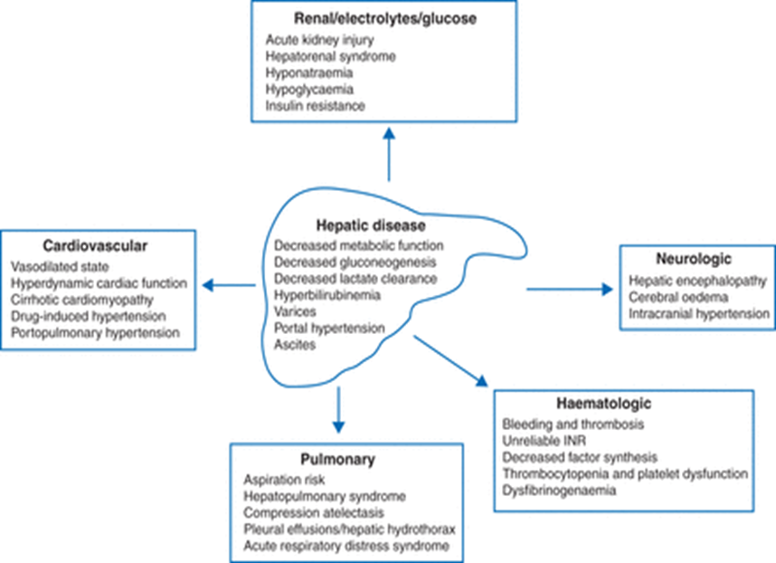

Slide 80
Gastro-intestinal
  Portal HTN
  Ascites
  Esophageal varices
  GI hemorrhage
  DGE
Notes:
Portal hypertension is often apparent preoperatively, as evidenced by dilated abdominal wall veins ( caput medusae) . Massive bleeding from gastroesophageal varices is a major cause of morbidity and mortality, and, in addition to the effects of acute blood loss, the absorbed nitrogen load from the breakdown of blood in the intestinal tract can precipitate hepatic encephalopathy.
The cardiovascular changes observed in the patient with hepatic cirrhosis are usually that of a hyperdynamic circulation, although clinically significant cirrhotic cardiomyopathy is oft en present and not recognized
There may be a reduced cardiac contractile response to stress, altered diastolic relaxation, downregulation of β-adrenergic receptors, and electrophysiological changes as a result of cirrhotic cardiomyopathy. Echocardiographic examination of cardiac function may initially be interpreted as normal because of significant afterload reduction caused by low systemic vascular resistance.
Disturbances in pulmonary gas exchange and ventilatory mechanics are oft en present. Hyperventilation is common and results in a primary respiratory alkalosis. As noted above, hypoxemia is frequently present and is due to right-to-left shunting of up to 40% of cardiac output. Shunting is due to an increase in both pulmonary arteriovenous communications (absolute) and ventilation/perfusion mismatching (relative). Elevation of the diaphragm from ascites decreases lung volume, particularly functional residual capacity, and predisposes to atelectasis. Moreover, large amounts of ascites produce a restrictive ventilatory defect that increases the work of breathing.
Anemia, thrombocytopenia, and, less commonly, leukopenia, may be present. The cause of the anemia is usually multifactorial and includes blood loss, increased red blood cell destruction, bone marrow suppression, and nutritional deficiencies. Congestive splenomegaly secondary to portal hypertension is largely responsible for the thrombocytopenia and leukopenia. Coagulation factor deficiencies arise as a result of decreased hepatic synthesis. Enhanced fibrinolysis secondary to decreased clearance of activators of the fibrinolytic system may also contribute to the coagulopathy.
Hepatic encephalopathy is characterized by alterations in mental status with fl uctuating neurological signs (asterixis, hyperreflexia, and/or inverted plantar reflex) and characteristic electroencephalographic changes (symmetric high-voltage, slow-wave activity). Some patients also have elevated intracranial pressure. Metabolic encephalopathy seems to be related to both the amount of hepatocellular damage present and the degree of shunting of portal blood away from the liver and directly into the systemic circulation. Th e accumulation of substances originating in the gastrointestinal tract (but normally metabolized by the liver) has been implicated. Factors known to precipitate hepatic encephalopathy include gastrointestinal bleeding, increased dietary protein intake, hypokalemic alkalosis from vomiting or diuresis, infections, and
worsening liver function.

Slide 81
Portal hypertension
Elevated PV pressure(portal pressure >10 mmHg) associated with any two of the following criteria
  Splenomegaly, hepatomegaly, peripheral edema, ascites or bleeding esophageal varices
Portal hypertension may initially be treated with b-blockers such as propranolol.
Octreotide or vasopressin may be added to control gastrointestinal bleeding.

Slide 82
Ascites
Ascites is the most common complication of cirrhosis leading to hospitalization
Massive ascites can raise intra-abdominal pressure with adverse effects on respiratory and renal function
Ascites is normally treated with sodium and water restriction; however, abdominal paracentesis is occasionally required
If drainage of ascites is necessary, the simultaneous infusion of i.v. colloids or human albumin solution, and drainage of no more than 5 litres is recommended

Slide 83
Hepato-renal syndrome
Functional renal failure that is associated with severe liver disease is called hepatorenal syndrome
The exact pathophysiology is unknown, but it appears that dehydration and diminished renal blood flow often precede the decrease in GFR and development of azotemia
It is characterized by progressive oliguria with avid sodium retention, azotemia, intractable ascites, and a very high mortality rate.
Treatment is supportive and oft en unsuccessful unless liver transplantation is undertaken

Slide 84
Hepato-pulmonary syndrome
Characterized by chronic arterial hypoxemia caused by intrapulmonary vascular dilatations and V/Q mismatch
Impaired pulmonary function in absence of cardiopulmonary disease
A clinical triad of liver disease, hypoxemia, and vascular dilatations
The resultant intrapulmonary vascular dilatation causes intrapulmonary R-L shunting and an increase in the alveolar to arterial oxygen gradient
Cyanosis, dyspnea, platypnea, orthodeoxia

Slide 85
Anesthesia for cirrhosis
Preoperative
  The number of surgical patients with liver dysfunction requiring surgery is on the rise(1: 700)
  Patients with cirrhosis are at increased risk for deterioration of liver function because of their limited functional reserves.
  Successful anesthetic management of these patients is dependent on recognizing the multisystem nature of cirrhosis and controlling or preventing its complications
  The risks of anesthesia in this group are related to where the patient lies on the liver disease spectrum, from subclinical to end-stage liver disease

Slide 86
Optimal preparation may decrease both peri-operative death and post-operative complications
The risk-benefit of carrying out surgery needs to be carefully considered as a patient has been fully assessed
Contraindications to elective surgery include
  fulminant hepatic failure, acute viral or alcoholic hepatitis,
  chronic active symptomatic hepatitis, CTP Class C cirrhosis,
  severe coagulopathy (platelet count<50 000 µl−1, uncorrectable PT >3 s above control),
  hypoxaemia, heart failure, and acute kidney injury.

Slide 87
Elective surgery should be postponed until illness has resolved, and liver tests normalized because of increased mortality and morbidity
Cause and degree of hepatic failure should be sought in setting of emergency surgery
Information should be obtained regarding recent drug exposures, including alcohol intake, intravenous drug use, recent transfusions, and prior anesthetics
The presence of nausea or vomiting should be noted, and, if present, dehydration and electrolyte abnormalities should be anticipated and corrected.

Slide 88
Pre-operative management includes addressing the primary features and secondary manifestations of liver disease to decrease the risk of perioperative complications or death
This includes optimization of electrolytes, intravascular volume status, coagulation and infection status.
Preoperative vitamin K and fresh frozen plasma (FFP) to correct the coagulation defect, and cryoprecipitate may also be required if the PT remains prolonged.

Slide 89
Ascites present at the time of surgery can lead to wound dehiscence, abdominal wall herniation and respiratory compromise
Diuretics and paracentesis may be required to relieve it
Ascitic fluid removal either pre-operatively, or intraoperatively at laparotomy, can lead to significant fluid shifts and intravascular volume depletion, potentially precipitating cardiovascular collapse.
Bolus colloid may be needed to manage this.

Slide 90
Gastric emptying is often delayed in this population and as such aspiration is a greater risk, pre-medication with H2 antagonists may be advisable
Sedative premedication should be avoided as it may precipitate encephalopathy
Perioperative blood transfusion should be minimized

Slide 91
Risk stratification
Perioperative risk is determined by both patient-specific and procedural factors
The type of surgical procedure influences perioperative outcomes in patients with hepatic disease
Patients with extensive liver disease who undergo abdominal surgery have a mortality rate of 30%.
Patients with coagulopathy or CTP Class C cirrhosis are at even higher risk during open cholecystectomies, abdominal surgeries, and cardiovascular procedures

Slide 92
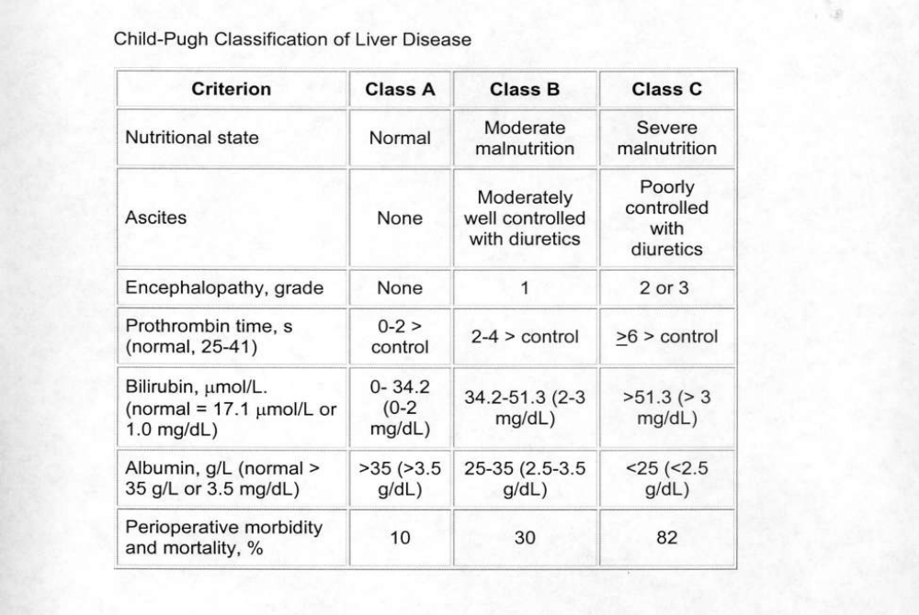

Slide 93
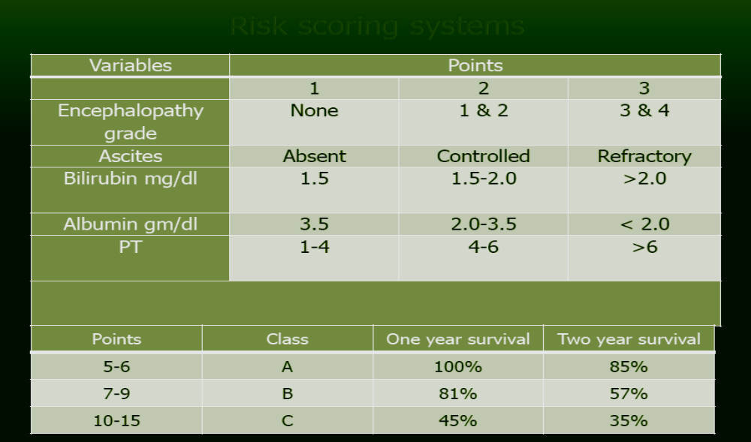

Slide 94
This scoring system relies on a subjective assessment of ascites and encephalopathy and does not consider preoperative infection, etiology of cirrhosis, or surgery type
Studies suggested high mortality rates in Class A patients (10%), Class B patients (82%), and Class C patients (82%) who undergo abdominal surgeries
However, advancements in anesthetic and surgical techniques might have reduced the mortality rate.

Slide 95
Intraoperative
  The goal of intraoperative management is to preserve existing hepatic function and avoid factors that may be detrimental to the liver
  Patients with post necrotic cirrhosis due to hepatitis B or hepatitis C who are carriers of the virus may be infectious.
  Universal precautions are always indicated in preventing contact with blood and body fluids from all patients
  The response to anesthetic agents is unpredictable in patients with cirrhosis.

Slide 96
Some patients with viral hepatitis may exhibit increased central nervous system sensitivity to anesthetics, whereas alcoholic patients will often display cross-tolerance to both intravenous and volatile anesthetics
Changes in central nervous system sensitivity, volumes of distribution, protein binding, drug metabolism, and drug elimination are common
An increase in the volume of distribution for highly ionized drugs. Ex, NMBAs

Slide 97
Anesthetic Technique
  The planned anesthetic technique should preserve HBF and oxygen delivery
  RSI with cricoid pressure is best employed technique
  A propofol induction followed by isoflurane or sevoflurane in oxygen or an oxygen–air mixture is commonly employed for general anesthesia
  In unstable patients, usage of ketamine or etomidate is advised
  Inhalation anesthetics are generally preferable to intravenous agents because most of the latter are dependent on the liver for metabolism or elimination

Slide 98
Opioid supplementation reduces the dose of the volatile agent required, but the half lives of opioids are often significantly prolonged
Standard induction doses of intravenous induction agents can generally be used because their action is terminated by redistribution rather than metabolism or excretion
A prolonged duration of action, however, may be encountered with large or repeated doses of intravenous agents
Isoflurane and sevoflurane are the volatile agents of choice because they preserve hepatic blood flow and oxygen delivery

Slide 99
Atracurium or cisatracurium may be the NMB of choice because of its non hepatic metabolism
Factors known to reduce hepatic blood flow, such as hypotension, excessive sympathetic activation, and high mean airway pressures during controlled ventilation, should be avoided
Regional anesthesia may be used in patients without thrombocytopenia or coagulopathy, but hypotension must be avoided

Slide 100
Monitoring
  Routine monitoring should be established pre-induction
  Pulse oximeter
  ABG
  ECG
  Vital signs continously
  Glucose
  Electrolytes
  UOP
  Neuromuscular block

Slide 101
Invasive monitors in unstable patients
  IABP
  CVP-useful in assessing patient response to fluid therapy

Slide 102
Fluid management
Most patients are sodium-restricted preoperatively, but intravascular volume and urinary output should be preserved intra-operatively
The use of colloid intravenous fluids (albumin) may be preferable to avoid sodium overload and to increase oncotic pressure.
Intravenous fluid replacement should take into account the excessive bleeding and fluid shifts that often occur in these patients during abdominal procedures.

Slide 103
Aggressive intravenous fluid replacement is often necessary to prevent profound hypotension and kidney failure
  Removal of ascitic fluid and long procedure results in large fluid shifts
These patients usually have greater transfusion requirement and had multiple previous transfusion
Most patients are anemic and coagulopathic, and perioperative transfusion may lead to hypocalcemia (citrate toxicity) because of elevated plasma citrate levels resulting from impaired citrate metabolism in the cirrhotic liver.

Slide 104
Uncontrolled haemorrhage and massive transfusion in the operating theatre or the intensive care unit can cause the lethal triad of acidosis, coagulopathy, and hypothermia
Warming the room, applying forced warming systems, administering blood products and fluids through a fluid warmer, and heating and humidifying inspired gases reduce the risk of hypothermia
Dilutional coagulopathy and thrombocytopenia may be prevented by transfusing packed red blood cells, fresh-frozen plasma, and platelets in a 1:1:1 ratio

Slide 105
Post-operative management
Patients with hepatic disease are at high risk for poor perioperative outcomes
Anesthesia and surgical interventions in patients with significant liver dysfunction precipitate decompensation
Patients with decompensated liver disease are at increased risk of postoperative hepatic failure, infection, sepsis, bleeding, poor wound healing and renal dysfunction
Hence postoperative critical care management should be considered for all Childs A, B and C patients.

Slide 106
Close monitoring and the minimization of exacerbating factors is needed to reduce this risk as far as possible
Post operative pain relief can be challenging
The role of regional techniques is very much restricted by the high incidence of coagulation defects.
Placement of epidural catheters should be undertaken with caution and with careful consideration to timing of catheter removal
Similarly, IM and SC injections can lead to haematoma formation and should be avoided.

Slide 107
NSAID and their association with increased risk of GI bleeding, platelet dysfunction and nephrotoxicity means they are often avoided
Paracetamol is sometimes used in this patient group, depending on the origin of their liver dysfunction
Fentanyl PCA is generally well tolerated, but accumulation can occur over time, morphine PCA can also be used but a lower bolus dose may be needed, again to avoid accumulation
  Close monitoring needed in both cases

Slide 108
Post-operative hepatic dysfunction
Postoperative liver dysfunction is considered in the presence of asymptomatic elevation of hepatic transaminases, jaundice, and/or symptoms suggestive of liver failure, such as encephalopathy
Mild elevations of liver enzymes can occur after surgery, particularly upper abdominal procedures
Surgical manipulation of the splanchnic bed may reduce both PBF and HABF, in part because of resultant systemic arterial hypotension mediated by prostacyclin induced dilation of the venous capacitance vessels

Slide 109
Elevations that are less than two times the upper limit of normal are frequently transient and do not require investigation.
More severe elevations suggest hepatocellular injury, which can result from a number of causes including hypoxemia, viral or bacterial insult, trauma, and chemical toxicity
Asymptomatic, mild elevations of hepatic enzymes are not unusual within hours after surgery, but they do not usually persist for more than 2 days.

Slide 110
The nature and site of the surgical procedure is an important risk factor for postoperative liver failure
Abdominal surgery appears to reduce hepatic blood low significantly. Abdominal traction can elevate prostaglandin levels, which may be responsible.
Not surprisingly, hepatic resection is a risk factor for postoperative liver failure
Cardiothoracic surgery is not well tolerated in cirrhotic patient, CPB was known to exacerbate preexisting liver dysfunction

Slide 111
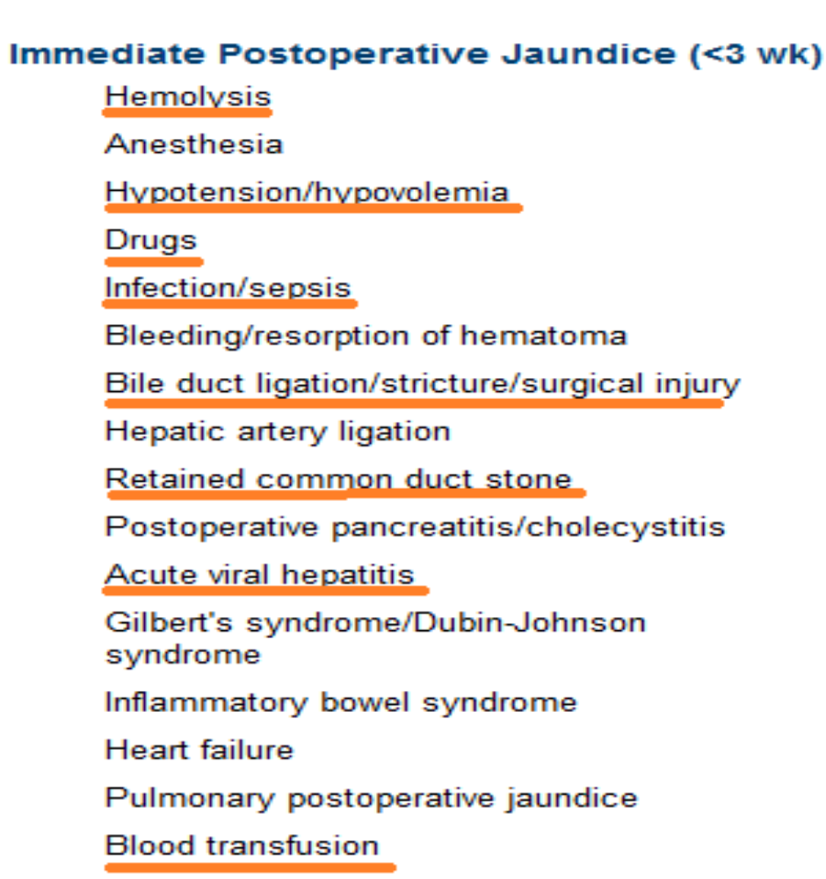
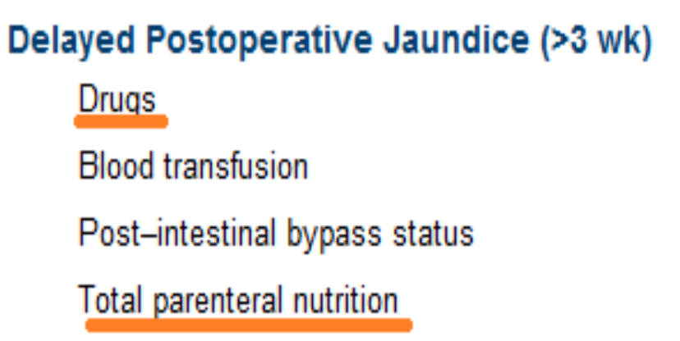
Causes of postoperative jaundice

Slide 112
Summary
Patients with liver disease are at increased risk for both perioperative morbidity and mortality
Assessment of the severity of liver dysfunction and consideration of type of surgery stratifies risk and delays elective surgery in patients with significant hepatic disease (CTP Class C cirrhosis)
Managing surgical patients with hepatic disease considers anesthetic dose adjustment and monitoring the multisystem organ responses to liver dysfunction
The multi‐system impact of liver failure means assessment and management of these patients often requires multi‐disciplinary discussion and critical care admission to optimize outcome

